Slide 2

School of Computer Science and Engineering
University of Petroleum And Energy Studies
Bidholi Campus, Energy Acres, Dehradun – 248007.
Minor-2
Project Title: IOT Based Alert Generator For Mining Workers
SUBMITTED BY:
SHIVANG RAJ
Sap Id: 500055050
NITISH KUMAR
Sap Id: 500063395
UNDER GUIDANCE OF :
Ms. NINNI SINGH
(Assistant Professor of Informatics)

Slide 3
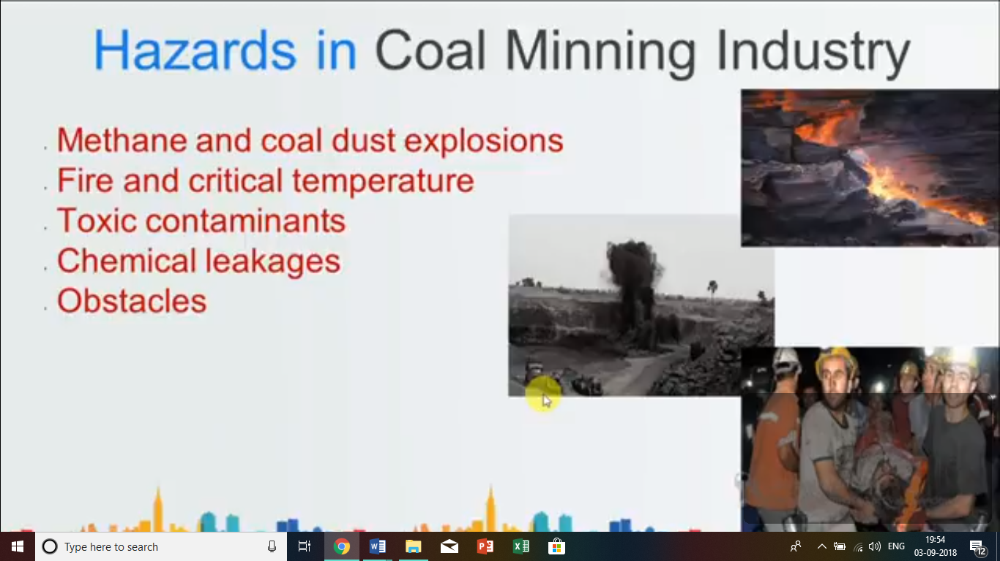
INTRODUCTION
The most important part of any type of industry is safety.
To avoid any types of unwanted conditions, every mining industry follows some basic precaution, Despite of several government regulations.
Which keeps workers at high risk.

Slide 4
PROBLEM STATEMENT
Our Objective is to design a IOT Based Alert Generator Device for workers working in mining industries.
Justification
Miners working at field are
Exposed to different hazardous gases
Harmful for their health.

Slide 5
LITERATURE REVIEW
Author | Title | Contribution
Jagadeesh R, Dr. R. Nagaraja International Research Journal of Engineering and Technology (IRJET) | “IoT based Smart Helmet for unsafe event detection for mining industry” | The developed prototype is able to sense the quality of air, humidity, removing the helmet by miner, and crash of an object on head.The helmet module includes ARM7 microcontroller in conjunction with various sensors and ZigBee, while reporting module includes ZigBee at the receiving end and raspberry pi controller.
M. Naveen raj, P. Ashwin Kumar, R. Vignesh, K. Iniyan, M. Sri Krishna Prasanth International Journal of Pure and Applied Mathematics | “Internet of Things Based an Intelligent Helmet For Wireless Sensor Network” | The problem addressed in this paper was the improvement of a mining helmet in order to ensure more safety awareness between miners. When working with noisy equipment, being aware of one’s surroundings can sometimes be challenging. In the mining trade miners tend to get rid of their safety gear because the gear is too significant, heat or uncomfortable to work with. So, this system is developed to intimate the authorities in critical conditions.
Shruti P. Borkar, V. B. Baru | IoT Based Smart Helmet for Underground Mines” | A mining helmet is developed that is able to detect different types of hazardous events such as, humidity condition of mines, then temperature and existence of combustible gases, the helmet removing by miner, and light intensity inside the mines.

Slide 6
OBJECTIVE
IOT Based Alert Generator for Mining Workers
Sub Objective 1: Our project aims at developing real-time surveillance with early warning intelligence on harmful gases, temperature, humidity which Minimize Health Risks of Workers Within Mining Industry.
Sub Objective 2 :All these parameters are detected continuously by temperature sensor, carbon monoxide, gas sensor, humidity sensor and if they cross the pre-defined limit, then the user gets alert as the buzzer will automatically turn on with LED indications. Our project involves implementation of Wi-Fi module and add-on of
heartbeat sensor.

Slide 7
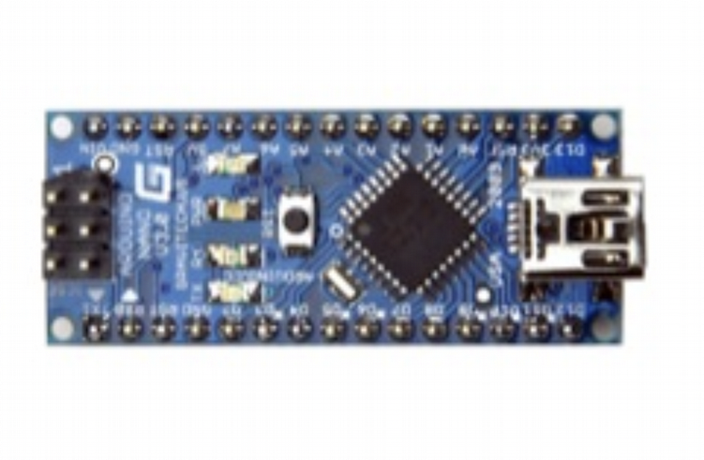
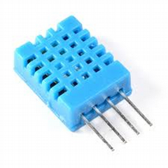
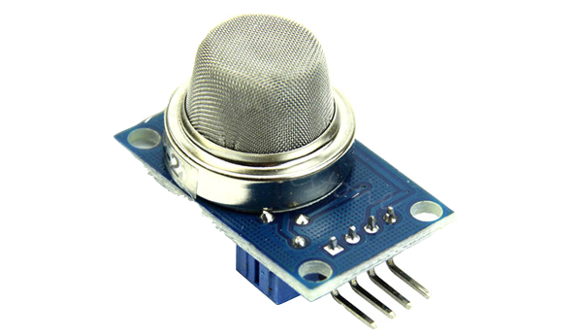
METHODOLOGY
Hardware requirement
5v Power Supply
Microcontrollers
Humidity and Temperature Sensor
Carbon Monoxide Sensor
LCD 20x4
LPG Gas Sensor
Buzzer
Wi-fi Module
Software Requirement
Arduino nano Atmega 328p
Embedded C language
Arduino
DHT11
MQ135

Slide 8

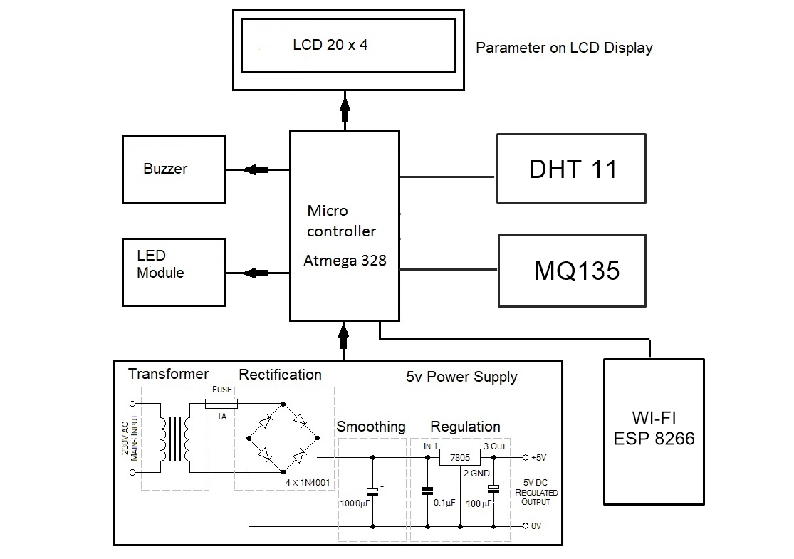
Block diagram

Slide 9
DHT 11 sensor
Temperature Range | 0-50°C /±2°C
Humidity Range | 20-80% / 5%
Sampling Rate | 1 Hz (once every second)
Body Size | 15.5mm x 12mm x 5.5mm
Operating Voltage | 3 to 5V
Max current During Measuring | 2.5mA
Distance | 5 to 10 Meter

Slide 10
MQ 135 Sensor
Detection Range: | 10 - 300 ppm NH3, 10 - 1000 ppm Benzene, 10 - 300 Alcohol
Heater Voltage: | 5.0V
Dimensions: | 18mm Diameter, 17mm High excluding pins, Pins - 6mm High
Distance | 3 to 10 meter
MQ 2 Sensor
Operating voltage | 5V
Load resistance | 20 KΩ
Heater resistance | 33Ω ± 5%
Heating consumption | <800mw
Sensing Resistance | 10 KΩ – 60 KΩ
Concentration Scope | 200 – 10000ppm
Distance | 5 to 12 meter

Slide 11
PERT CHART
START PERIOD
JAN 27-FEB 9
Study of Project & it’s requirements
FEB 10 – FEB 20
Design and Analysis of Algorithm
FEB 21- FEB 29
Code Analysis & Error Correction
MARCH 24-
APRIL 12
Coding
MARCH 11-MARCH 23
Release Prototype & Designing
MARCH 1-
MARCH 10
Implementation
APRIL 13-
APRIL 20
Publish Report
APRIL 21- APRIL 25
END

Slide 12
REFERENCES
[1]Jagadeesh R, Dr. R. Nagaraja, et al., “IoT based Smart Helmet for unsafe event detection for mining industry” “International Research Journal of Engineering and Technology (IRJET) e-ISSN: 2395 -0056 Volume: 04 Issue: 01 | Jan -2017”.
[2] M. Naveen raj, P. Ashwin Kumar, R. Vignesh, K. Iniyan, M. Sri Krishna Prasanth, et al., “IOT Based Smart Helmet for Unsafe Event Detection for Mining Industry” International Journal of Pure and Applied Mathematics Volume 118 No. 20 2018, 533-538.
[3] G. Ravi Kumar & B. Keerthi Reddy, et al., “Internet of Things Based an Intelligent Helmet for Wireless Sensor Network” International Journal of Engineering Sciences & Research Technology, June, 2018
[4] Shruti P. Borkar, V. B. Baru, et al., “IoT Based Smart Helmet for Underground Mines” International Journal of Research in Engineering, Science and Management Volume-1, Issue-9, September-2018
[5] G. Prabhakar Reddy et al., “IoT in Mines for Safety and Efficient Monitoring” International Journal of Advanced Research in Computer Engineering & Technology (IJARCET) Volume 4 Issue 11, November 2015

